Slide 1


Hospital Management System
A comprehensive digital solution for modern healthcare facilities covering OPD Management, IPD Management, and Pharmacy departments .

Slide 2
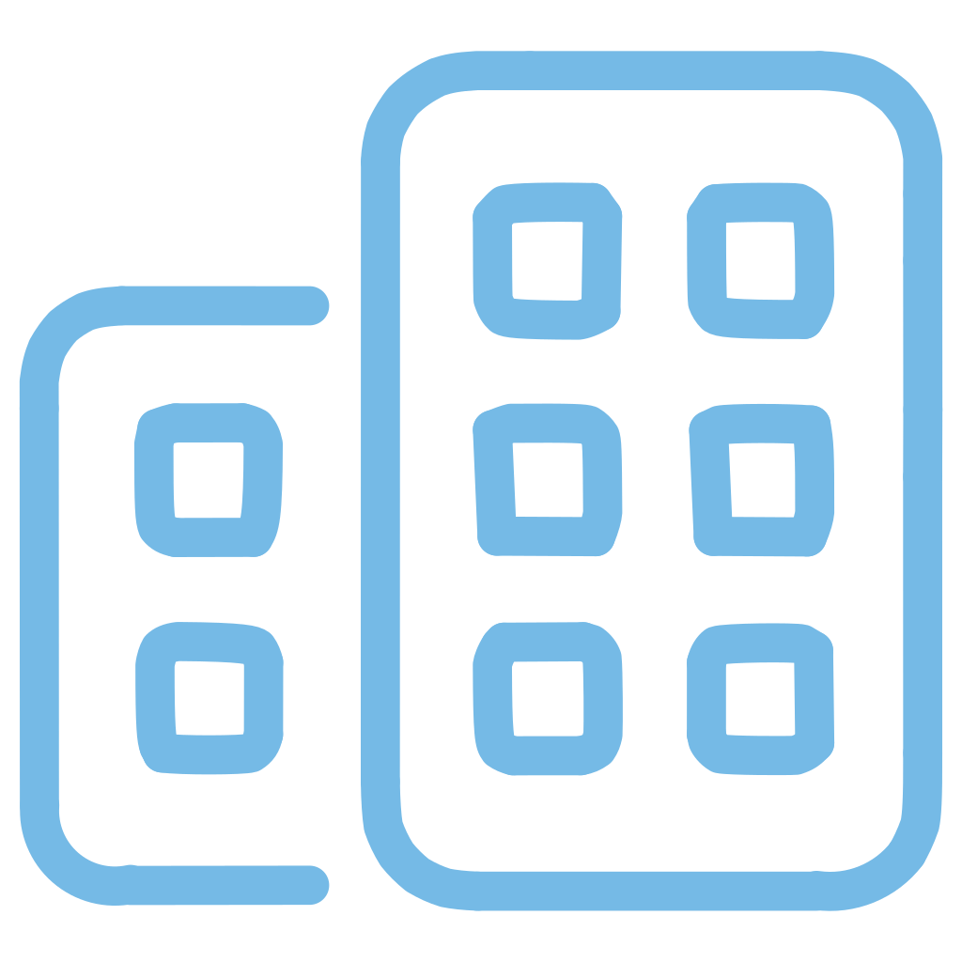
COMPANY OVERVIEW
Digitizing Healthcare Operations
Our Purpose
Xelogic Solutions delivers cutting-edge software designed to digitize and streamline the operational workflows of healthcare facilities. Our Hospital Management System revolutionizes how OPD, IPD, and Pharmacy departments function, creating seamless integration across all touchpoints of patient care.
Key Benefits
  Enhanced operational efficiency
  Improved patient care quality
  Reduced administrative costs
  Real-time data access
  Regulatory compliance
By replacing manual processes with intelligent automation, we help healthcare providers reduce administrative overhead while dramatically improving the speed, accuracy, and quality of patient care. Our platform serves as the digital backbone that connects departments, centralizes information, and empowers medical staff to focus on what matters most—patient outcomes.
www.xelogicsolutions.com

Slide 3
Understanding User Needs
Our Hospital Management System is built around the real challenges healthcare professionals face every day. We've designed solutions that directly address the pain points experienced by doctors, nurses, administrators, and patients alike.
Administrative Efficiency
Enhanced Patient Tracking
Seamless Communication
Dramatically reduce paperwork and manual data entry, freeing staff to focus on patient care rather than documentation
Monitor patient journeys from admission to discharge with real-time updates and comprehensive visibility
Enable instant coordination between departments with integrated messaging and notification systems
Instant Data Access
Error Reduction
Streamlined Billing
Retrieve patient histories, lab reports, imaging results, and prescriptions in seconds, not minutes
Minimize medical errors through automated checks, alerts, and validation at every step
Simplify insurance claims and payment processing with automated billing workflows
www.xelogicsolutions.com

Slide 4

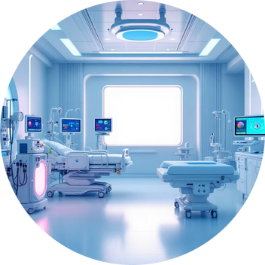


Comprehensive Hospital Information System
Our integrated platform connects every critical department in your healthcare facility, creating a unified ecosystem where information flows seamlessly and operations run efficiently.
OPD Management
IPD Management
Laboratory Services
Pharmacy Operations
Complete outpatient department solutions for appointments, consultations, prescriptions, and billing
Comprehensive inpatient care management from admission through discharge and follow-up
Integrated lab management for test orders, sample tracking, results, and reporting
End-to-end medication management including inventory, dispensing, and billing
www.xelogicsolutions.com

Slide 5

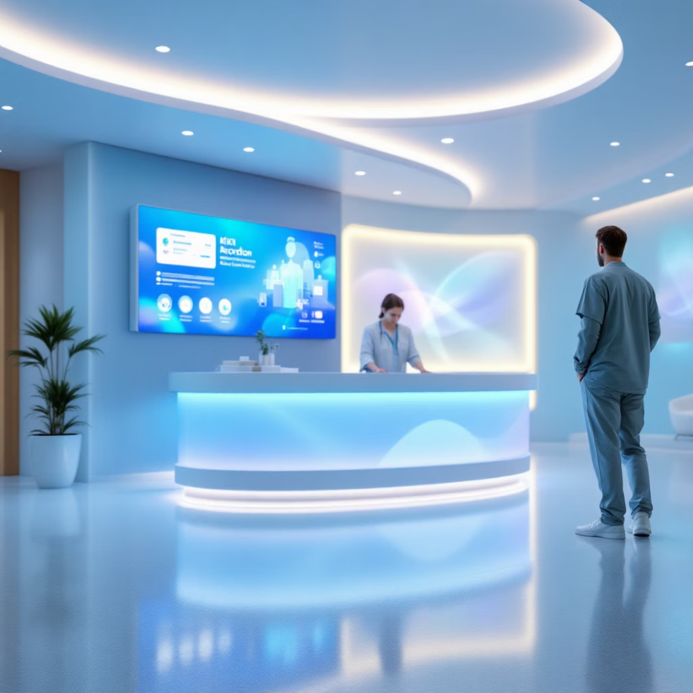
MODULE DETAILS
OPD Module Features
The Outpatient Department module is the front door of your healthcare facility, designed to create exceptional patient experiences while maximizing operational efficiency. From the moment a patient books an appointment to the completion of their visit, every interaction is streamlined and digitized.
01
Appointment Management
Online booking, walk-in registration, intelligent queue systems, and automated reminders via SMS and email
02
Patient Registration & EMR
Digital capture of demographics, secure electronic medical records, and integrated lab and imaging reports
03
Consultation Tools
Intuitive interfaces for doctors to record clinical notes, create prescriptions, and share treatment plans digitally
04
Billing & Invoicing
Automated billing for consultations, tests, and procedures with customizable fee structures and instant invoice generation
www.xelogicsolutions.com

Slide 6
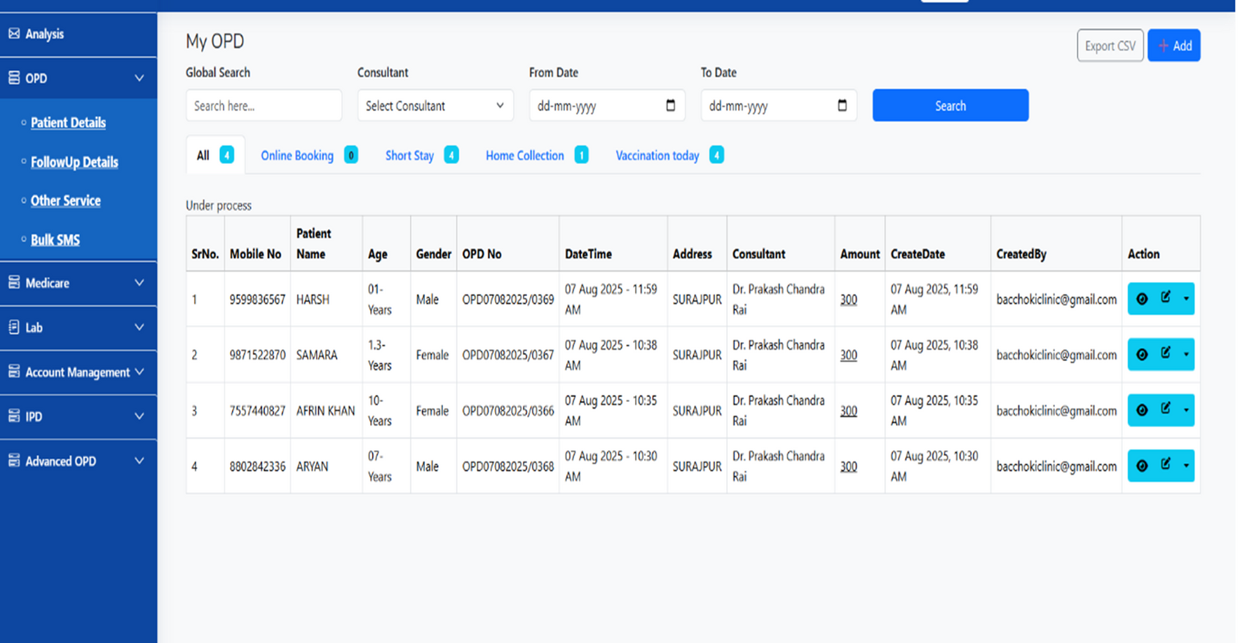
OPD DASHBOARD
www.xelogicsolutions.com

Slide 7
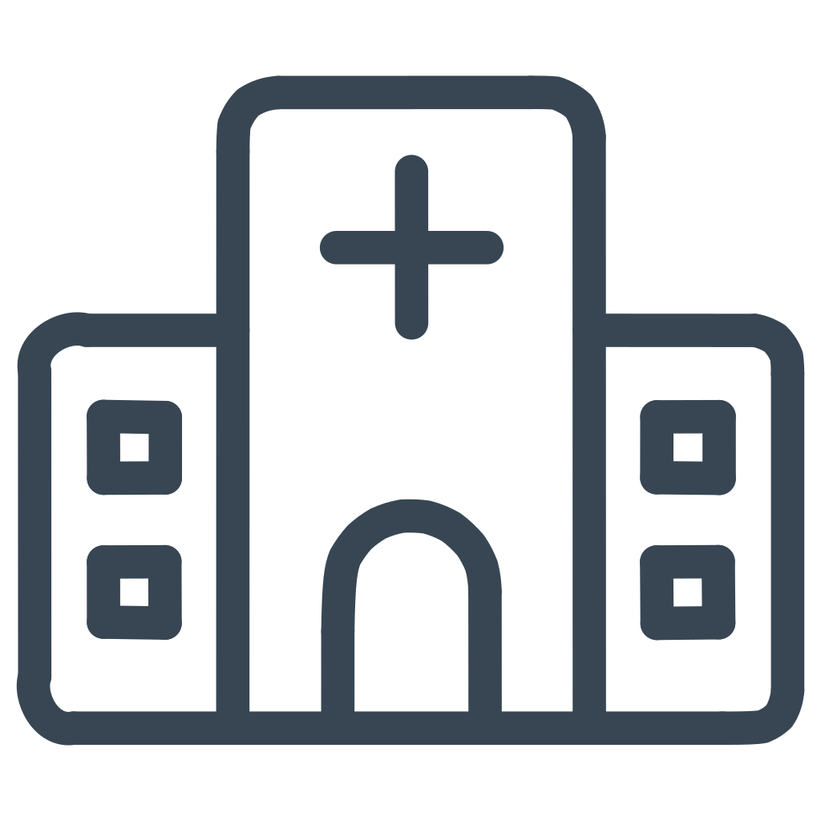








INPATIENT CARE
IPD Module Capabilities
The Inpatient Department module manages the complete patient journey for admitted patients, ensuring coordinated care, accurate documentation, and efficient resource utilization throughout their hospital stay.
Admission & Discharge
Patient Monitoring
Streamlined electronic admission processes, intelligent bed allocation with real-time availability tracking, and automated discharge summary generation
Continuous access to electronic medical records, automated treatment plan tracking, and real-time vital signs monitoring with IoT device integration
Surgery Management
IPD Billing
Comprehensive scheduling and management of surgical procedures with operation theater coordination and automated alerts for staff
Day-wise billing calculations, package pricing options, consumable item tracking, and seamless insurance claim processing
www.xelogicsolutions.com

Slide 8
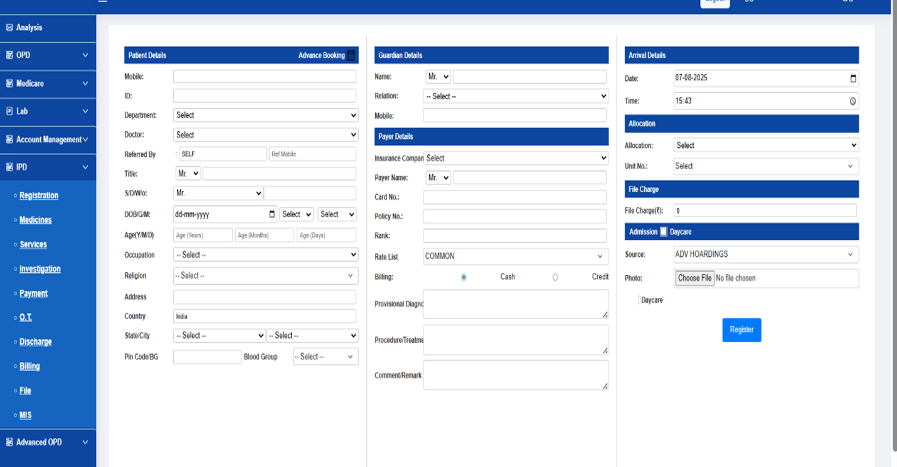
IPD DASHBOARD
www.xelogicsolutions.com

Slide 9

Pharmacy Module
Complete Medication Management
Key Pharmacy Features
The Pharmacy module ensures accurate, efficient medication distribution while maintaining comprehensive inventory control. From receiving digital prescriptions to dispensing medications and managing stock levels, every aspect of pharmacy operations is optimized.
  Barcode scanning integration
  Batch and expiry tracking
  Automated reorder points
  Drug interaction alerts
  Vendor management
  Generic substitution suggestions
Inventory & Stock Control
Real-time tracking of medication inventory with automated low-stock alerts, expiry date management, and intelligent reorder recommendations
Prescription Processing
Direct receipt of digital prescriptions from doctors, barcode-enabled dispensing for accuracy, and drug interaction checking
Billing & Sales Management
Instant bill generation for dispensed medications, multiple payment method support, and detailed sales reporting and analytics
www.xelogicsolutions.com

Slide 10
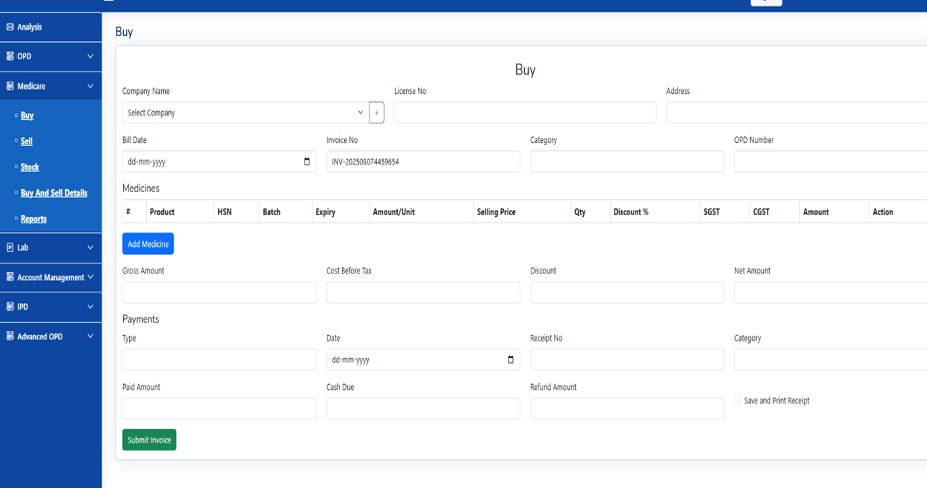
PHARMACY DASHBOARD
www.xelogicsolutions.com

Slide 11







SYSTEM REQUIREMENTS
Non-Functional Requirements
Beyond features and functionality, our Hospital Management System is built on a foundation of performance, security, and reliability that healthcare organizations demand. These critical requirements ensure the system operates flawlessly under all conditions.
Performance
Security & Compliance
Lightning-fast response times and efficient processing even during peak usage periods with thousands of concurrent users
HIPAA and GDPR compliant with role-based access control, end-to-end encryption, and comprehensive audit trails
Usability
Reliability
Intuitive interfaces designed for healthcare professionals with minimal training requirements and accessible design
99.9% uptime guarantee with redundant systems, automatic failover, and robust error handling mechanisms
Scalability
Cross-Platform
Architecture that grows with your organization, from small clinics to large multi-facility hospital networks
Seamless operation across desktop, tablet, and mobile devices with responsive design and offline capabilities
www.xelogicsolutions.com

Slide 12

Integration & Communication
External Interface Requirements
Our system is designed to work harmoniously within your existing technology ecosystem, connecting with various devices, applications, and communication channels to create a truly integrated healthcare environment.
User Interfaces
Hardware Integration
Consistent, intuitive design across all modules and devices for seamless user experience
Direct connectivity with medical IoT devices, vital sign monitors, and diagnostic equipment
Data Requirements
Protecting patient data while ensuring availability and integrity is paramount. Our comprehensive data management strategy includes:
Software Components
Communication Channels
  Automated Backups: Continuous data backup with multiple redundancy levels
  Disaster Recovery: Rapid recovery procedures with minimal data loss
  Data Integrity: Validation checks and audit trails at every transaction
  Security Measures: Multi-layer encryption and access controls
Built-in viewers for medical imaging (DICOM), PDF documents, and multimedia content
Multi-channel notifications via HTTP APIs, WhatsApp Business, SMS, and email integration
www.xelogicsolutions.com

Slide 13


Development Approach
Proven Methodology
Why Choose Xelogic
Xelogic Solutions employs a hybrid iterative-waterfall development model combined with a top-down architectural approach. This methodology allows us to deliver robust, well-planned systems while maintaining the flexibility to adapt to evolving requirements and incorporate user feedback throughout the development lifecycle.
  Proven track record in healthcare IT
  Comprehensive training and support
  Regular updates and enhancements
  Dedicated implementation team
  24/7 technical support
  Customization capabilities
Ready to transform your healthcare facility?
Our structured approach ensures thorough planning and documentation while enabling continuous improvement and rapid response to changing healthcare needs.
Contact us at xelogicsolutions.com
www.xelogicsolutions.com

